Slide 1
Facilitation of Circular Labour Migration of Haitian Seasonal Workers to the US under the H2 Visa Program
Project Progress to Date
November 14, 2014

Slide 2
Phase I Steps and Timeline
GoH H-2A Visa Task Force
Employer Outreach in the US/Assessment of Agricultural sites in Haiti
Stakeholder Workshop, Embassy Meeting
National Council of Agricultural Employers Conference
Aug. 6, 2014 | September | October | November | Dec. 5, 2014
Phase 1 end of activities

Slide 3
PHASE I
Planned activity | Status
Create the project steering committee | ✓
Identify and engage US employers and their agents: | ✓
Conduct site visits to communities of origin with employer agents and ONM; | ✓
Conduct a workshop in PaP for stakeholders involved in circular labor migration; | ✓
Conduct the baseline socio-economic study in communities of origin (CGD); | Pending
Deploy of ONM officers in the targeted areas; | ✓
Train ONM agents; | ✓
Conduct Haitian Consulates outreach – focus on their monitoring role | ✓
Notes:
PTP is a sole member LLC incorporated in Delaware.

Slide 4
H2A Process
Multiple Steps
Employer Application for worker visa Form I-29 to USCIS
Worker Application for U.S. Non-Immigrant Visa Form DS-160 to DoS
Worker Interview at U.S. Embassy
Employer State Job Order Form 790
Employer Application for Foreign Worker Certification Form 9142A to DoL
Visa Approved or Denied
Transportation to US Work Site
Pre-departure Training and Orientation
Notes:
PTP is a sole member LLC incorporated in Delaware.

Slide 5
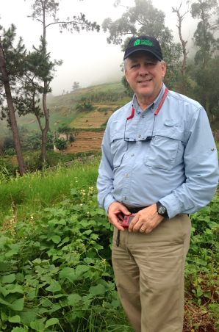
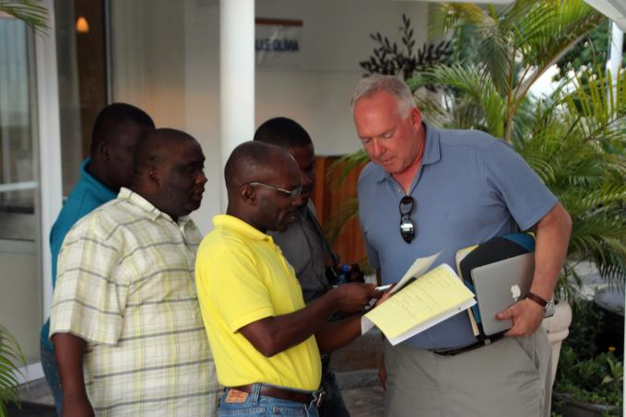
1. Engaging employers through the National Council
Current and past Presidents of the National Council of Agricultural Employers (NCAE)

Slide 6
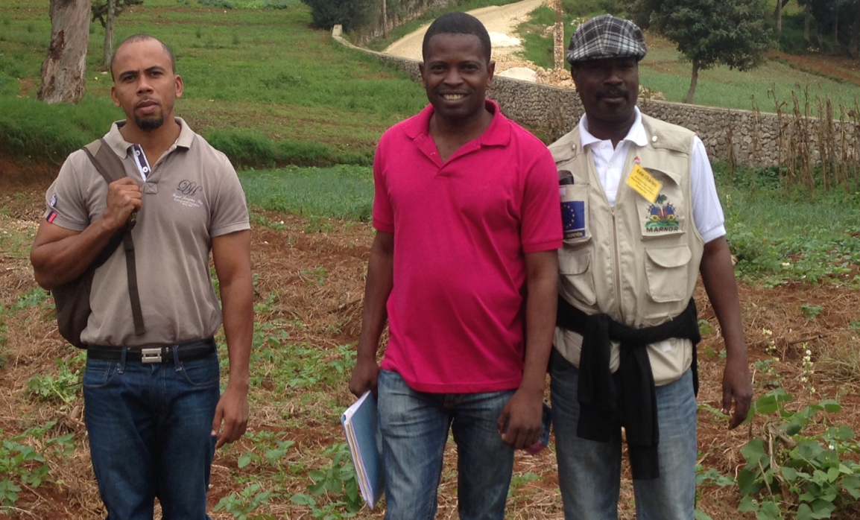
2. Capacity Building of the Government of Haiti
Engagement and Capacity Building of the Government of Haiti – Creation of Inter-Ministerial Task Force for the H-2A program

Slide 7
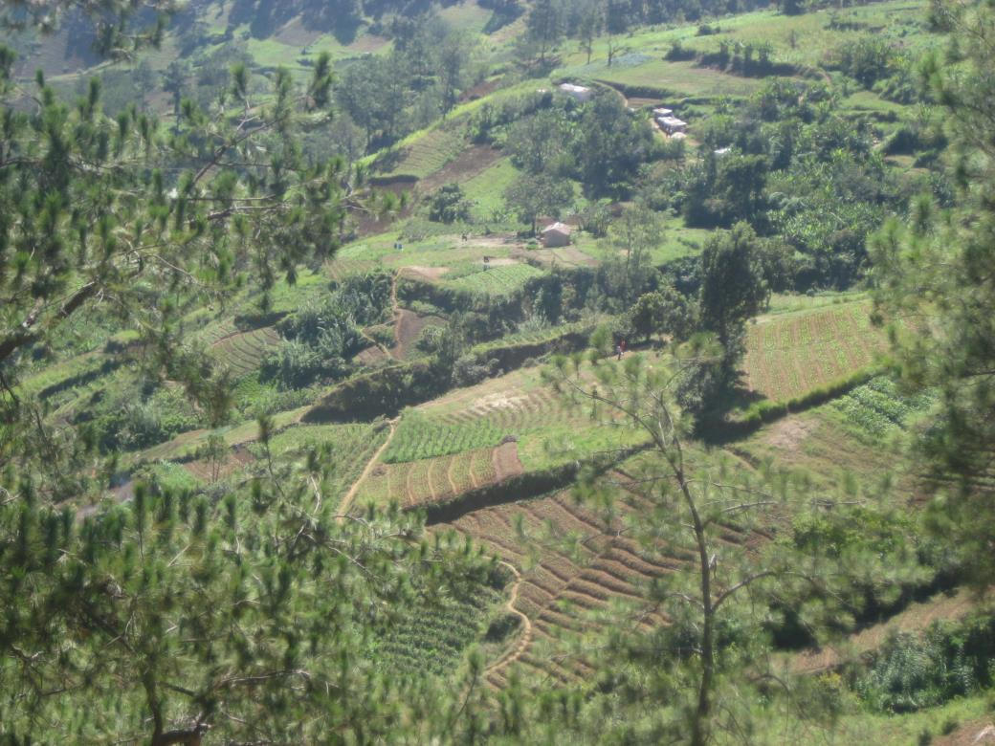
3. Assessment visits
7 Agricultural sites assessed and 200 workers pre-selected

Slide 8
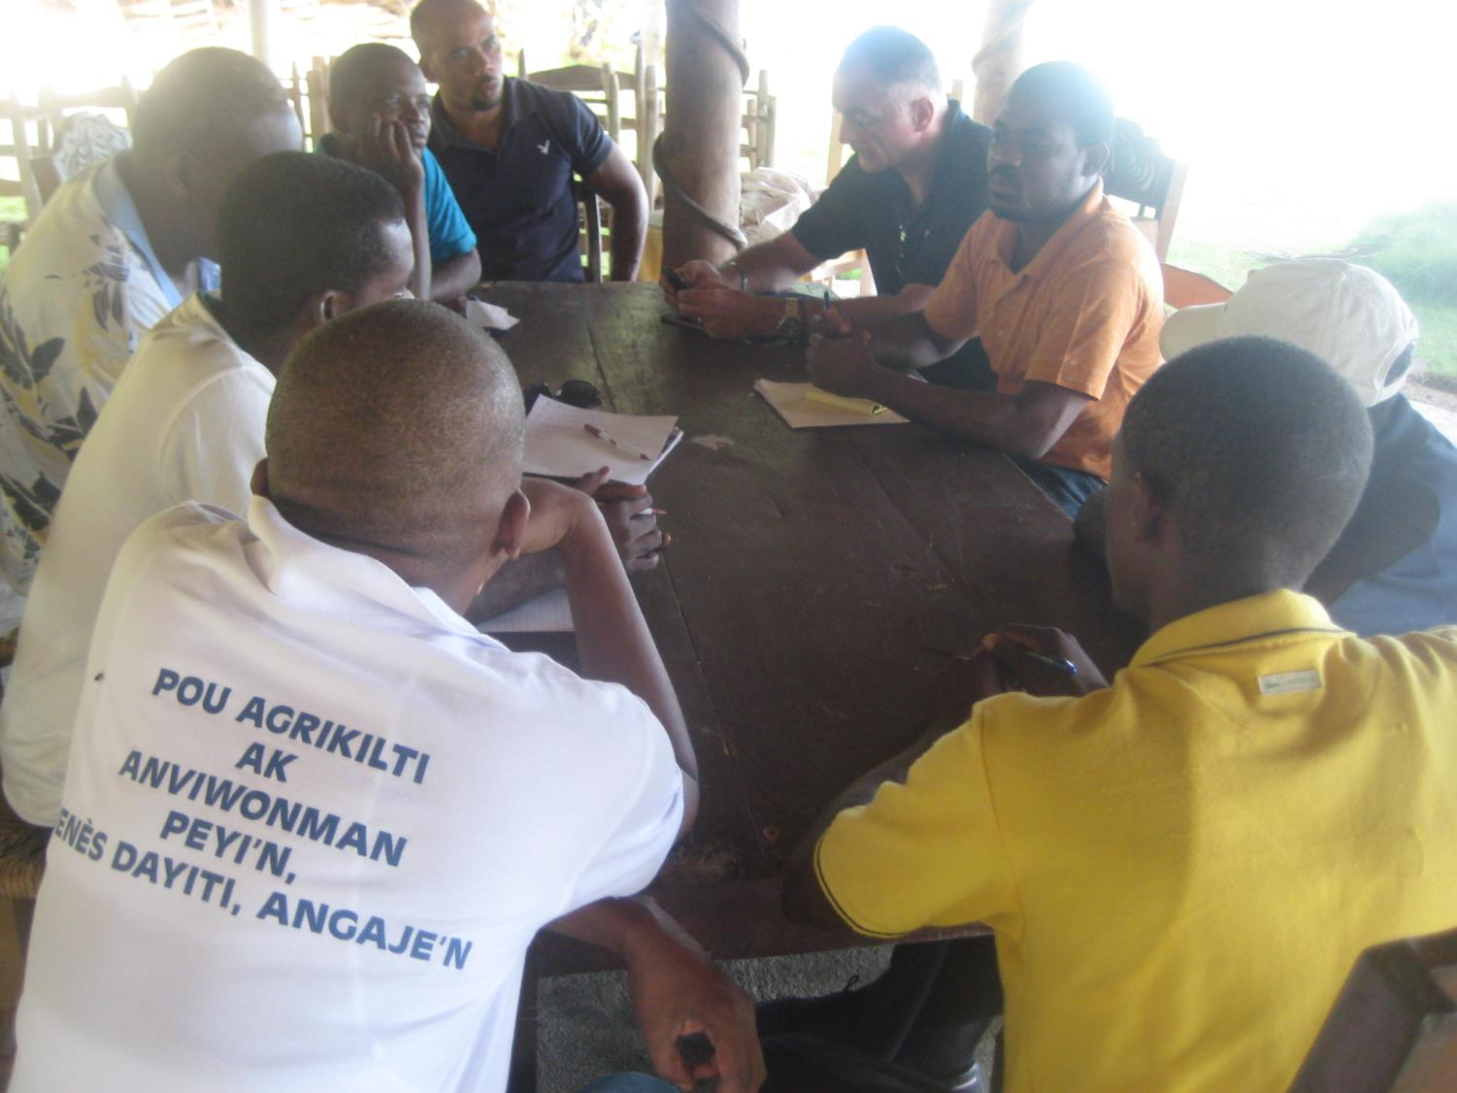

Slide 9
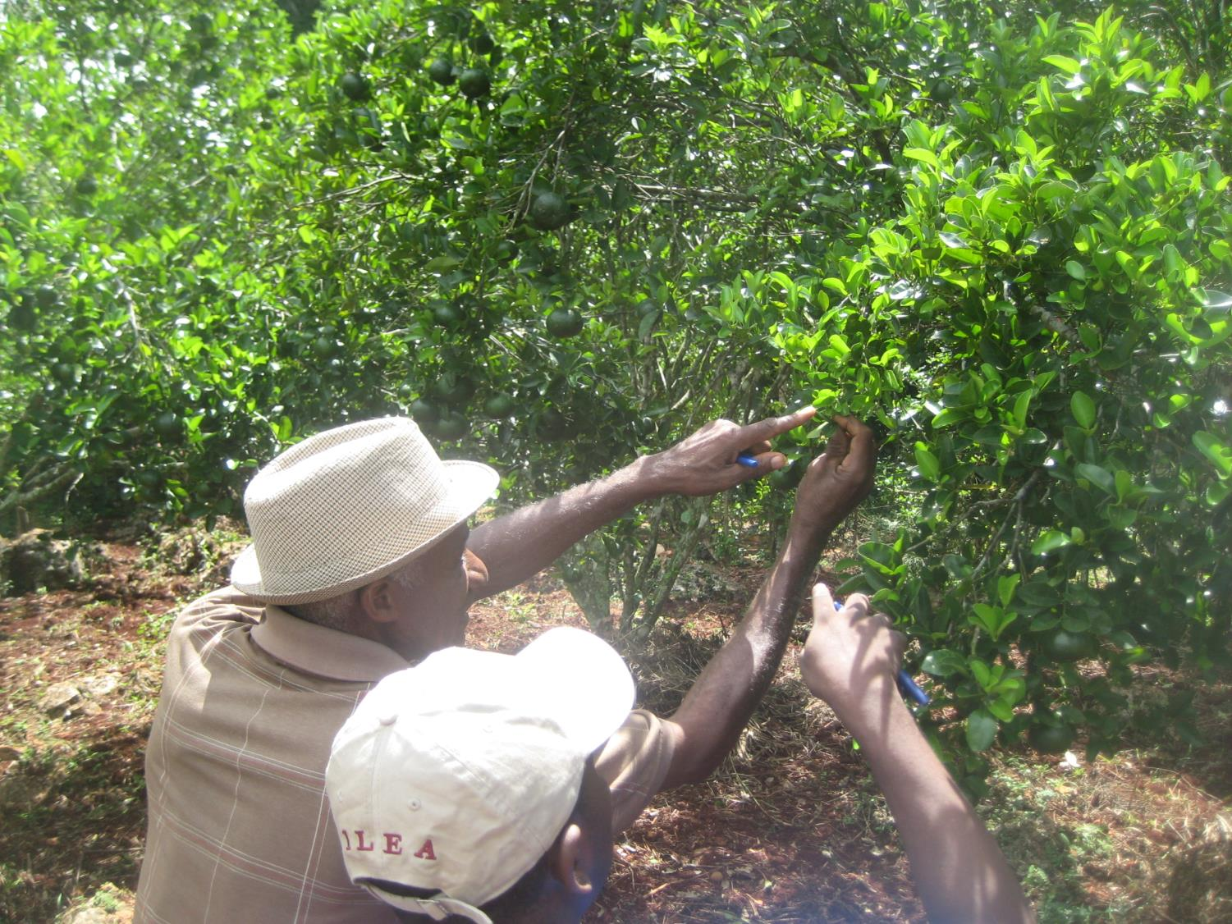

Slide 10
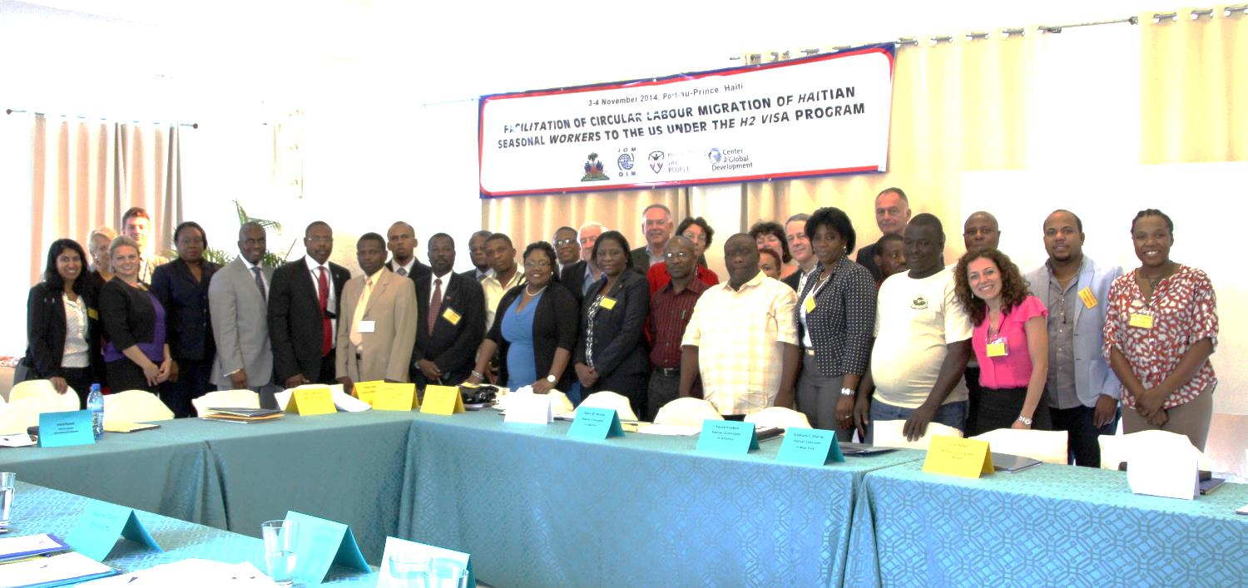
4. Stakeholder Workshop in Port-au-Prince, Nov 2-3

Slide 12
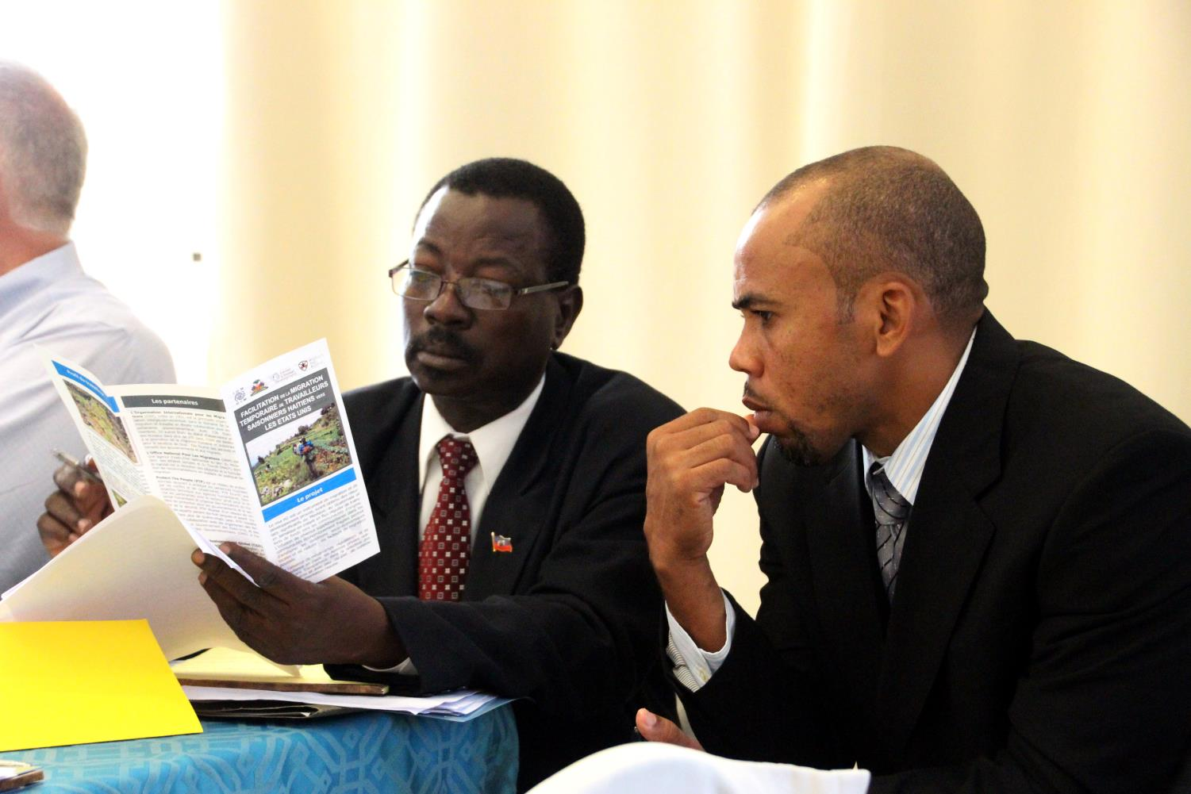

Slide 13
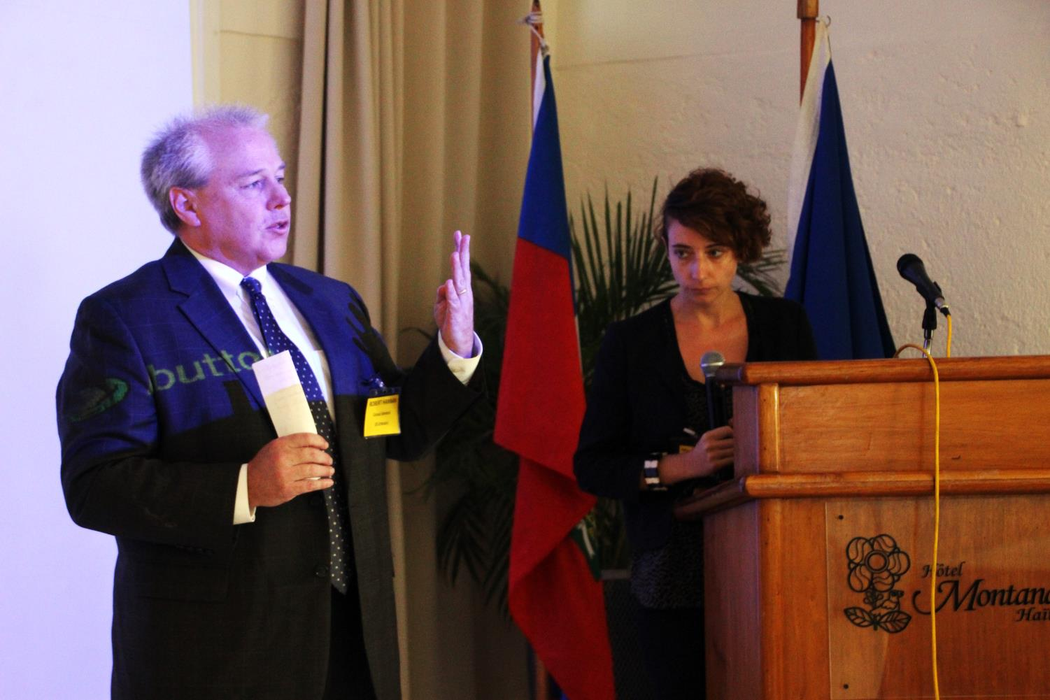

Slide 14
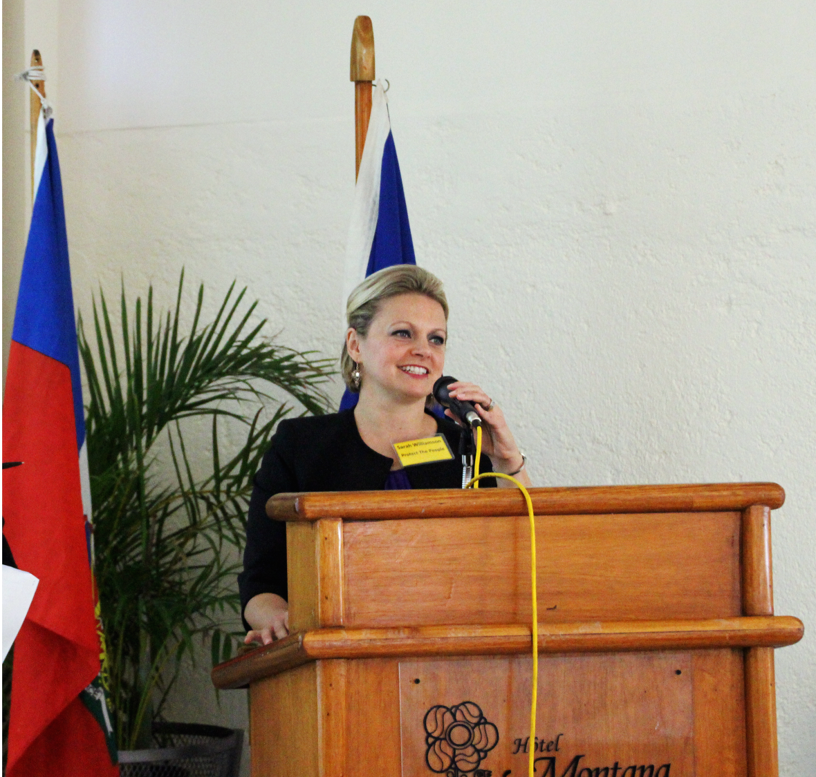

Slide 15
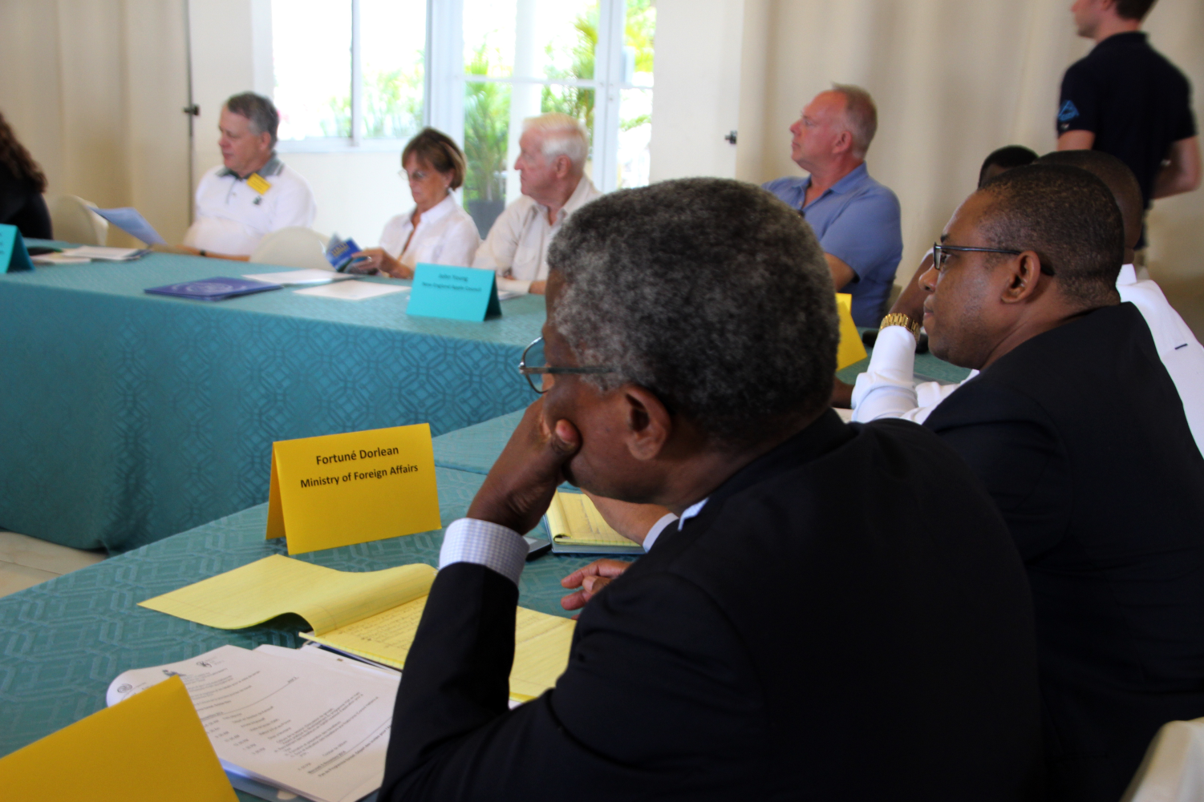

Slide 16
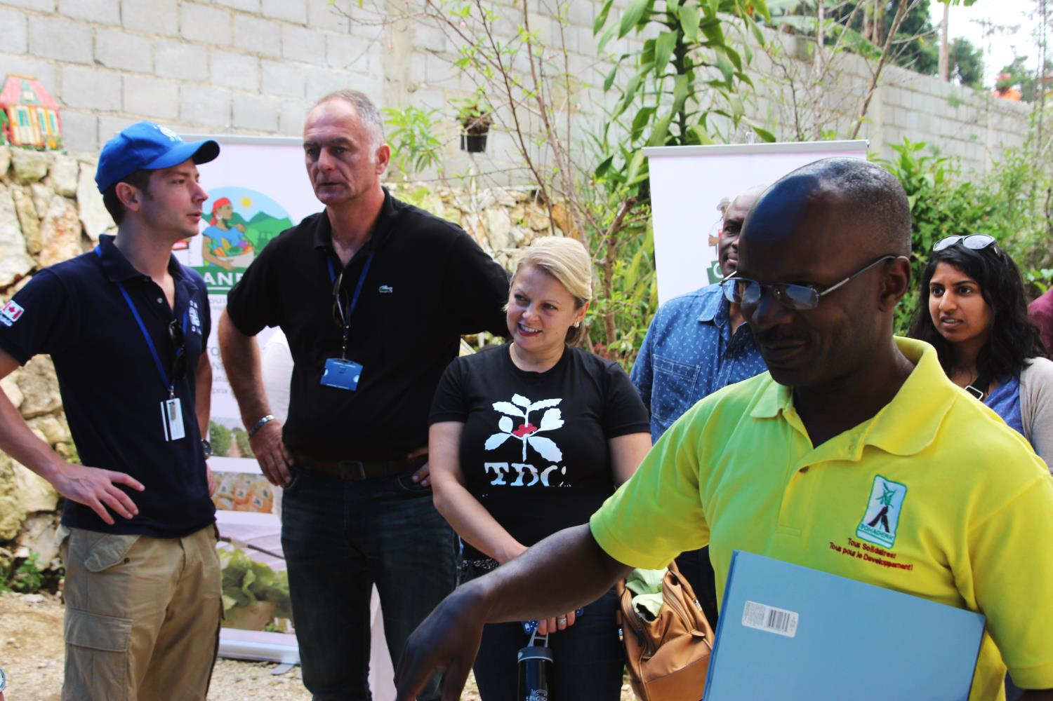

Slide 17
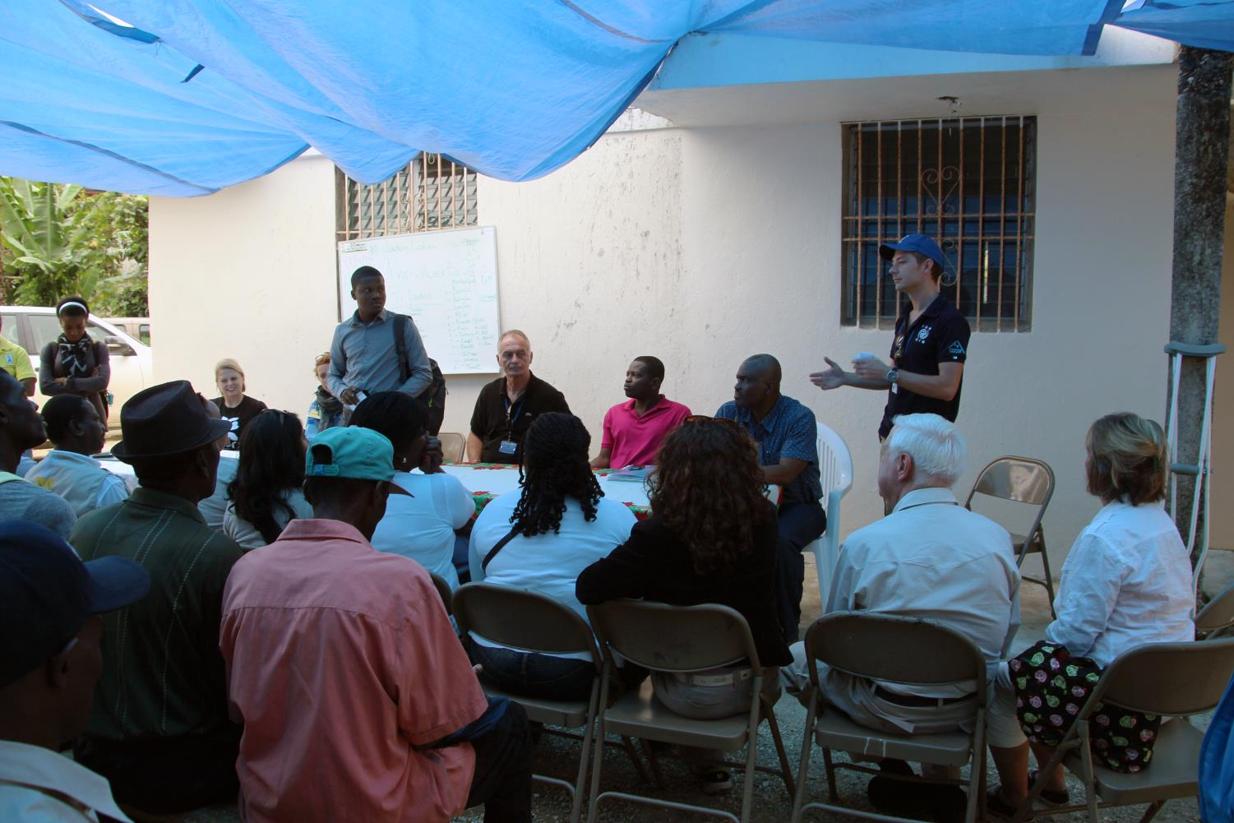

Slide 18
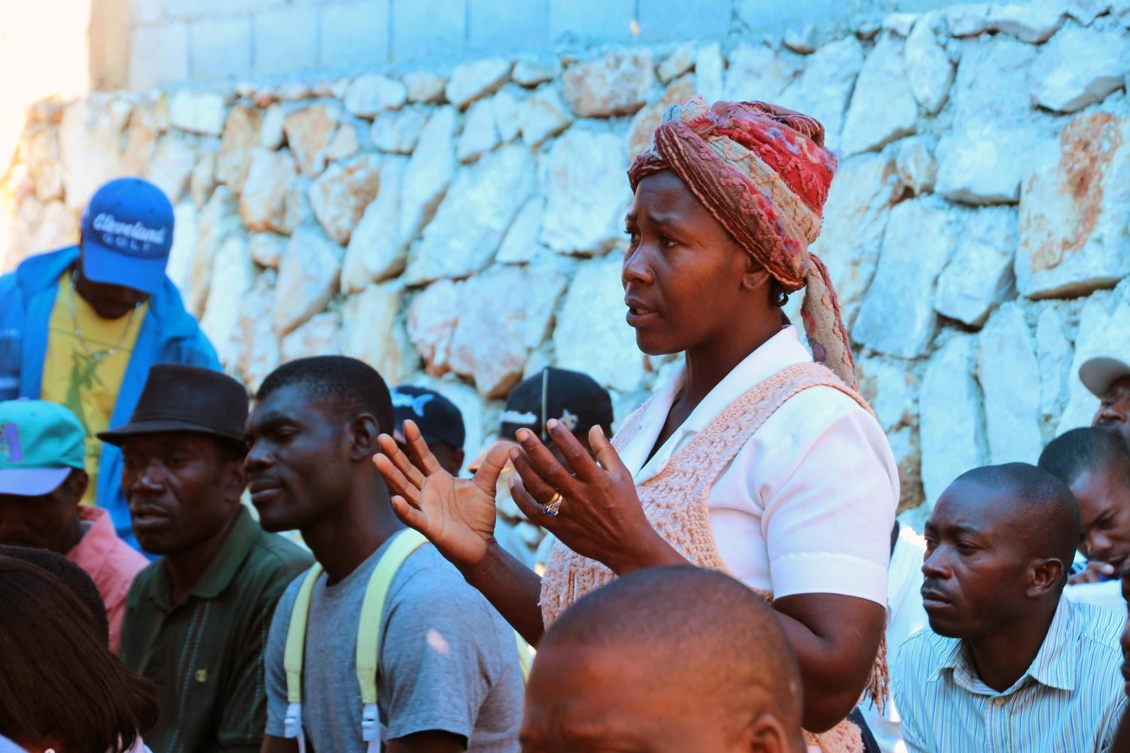

Slide 20
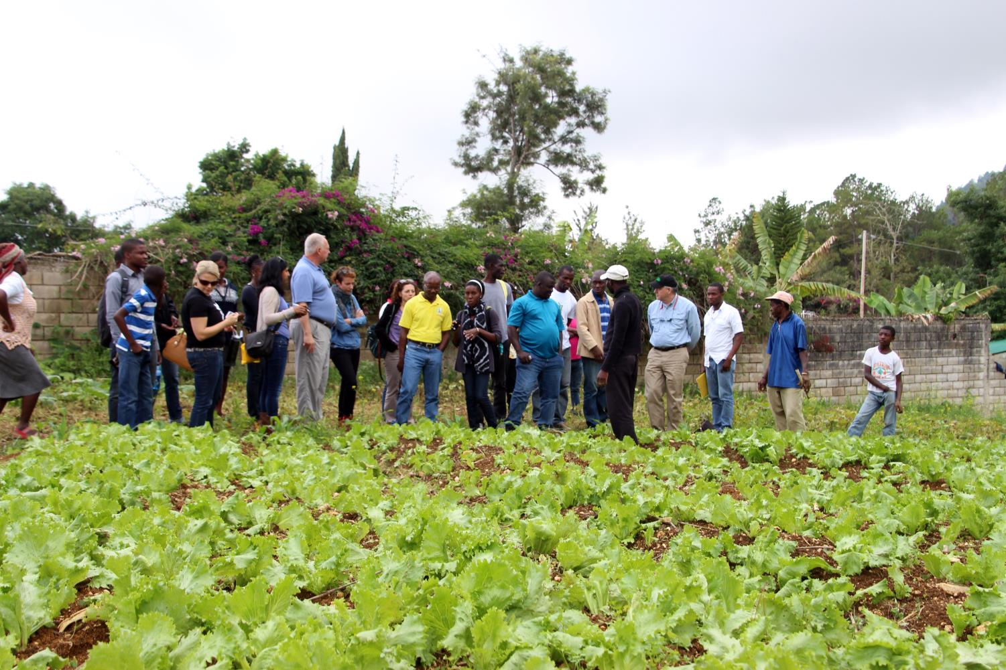

Slide 21
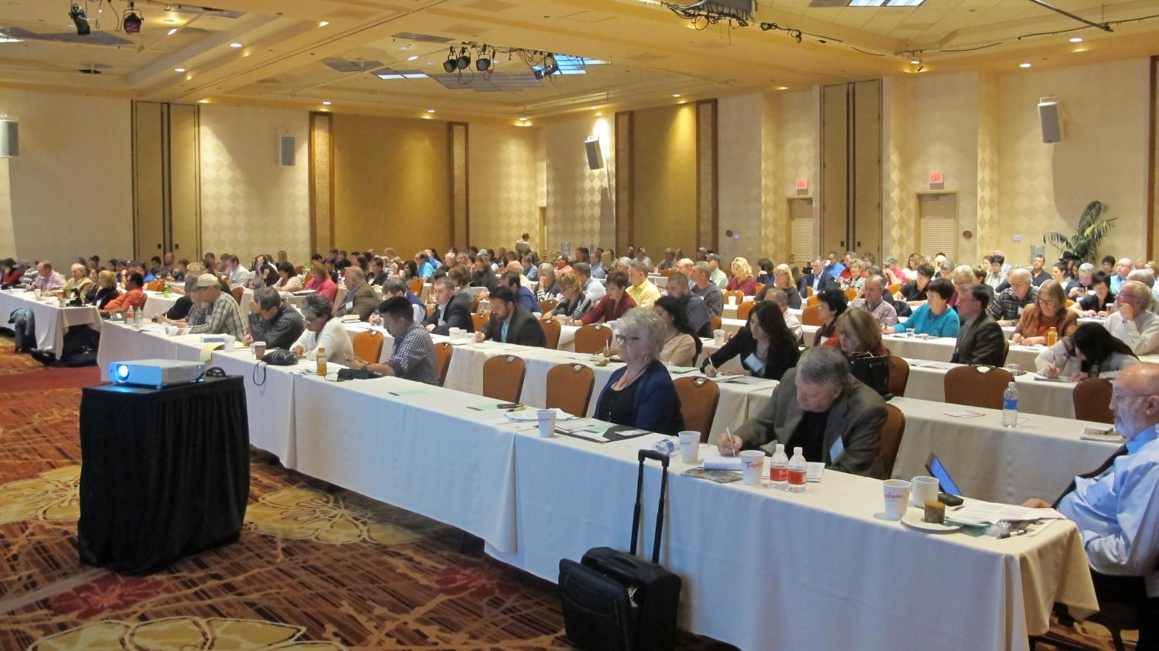
5. NCAE Conference, Las Vegas, Nov 12-13

Slide 22
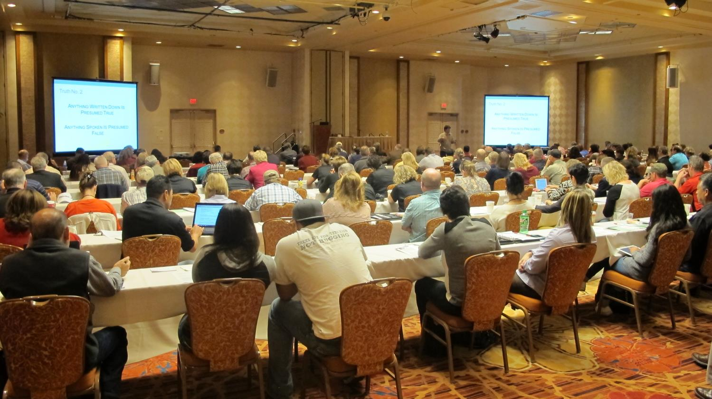

Slide 25
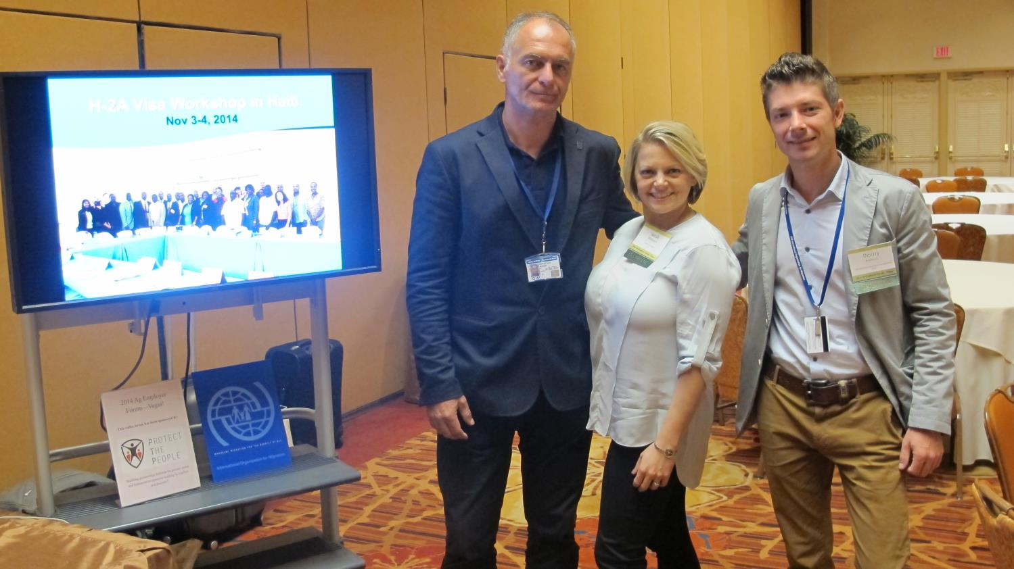

Slide 26
What are the next steps?
- Follow up with employers about job orders for Haitian workers in 2015
- Customized pre-departure training program
- Educational exchange for 10 Haitian agricultural associations to visit US farms
- Final selection of workers
- Departure and monitoring of workers in the US
- CGD study

Slide 27
PHASE II (December 2014 – December 2015)
Dec – Mar: Educational exchange for Haitian agricultural associations to visit US farms
Jan – Aug: Get job orders from US H-2A employers
Dec – Apr: Design a customized pre-departure training program
Mar – Oct: Arrival in the US and job placement
Mar – Oct: Monitoring missions by Haitian Consulates in the US
Sept – Dec: Community projects
Notes:
PTP is a sole member LLC incorporated in Delaware.

Slide 28
Conclusion:
The current condition for Phase II disbursal means IOM stops operations by December 5, 2014
Important to start Phase II by December 5, 2014
Letter authorizing the continuation of operations
Important to extend the project through Dec 2015
Disbursal of Phase II funds in January 1, 2015

Slide 29
